Slide 1
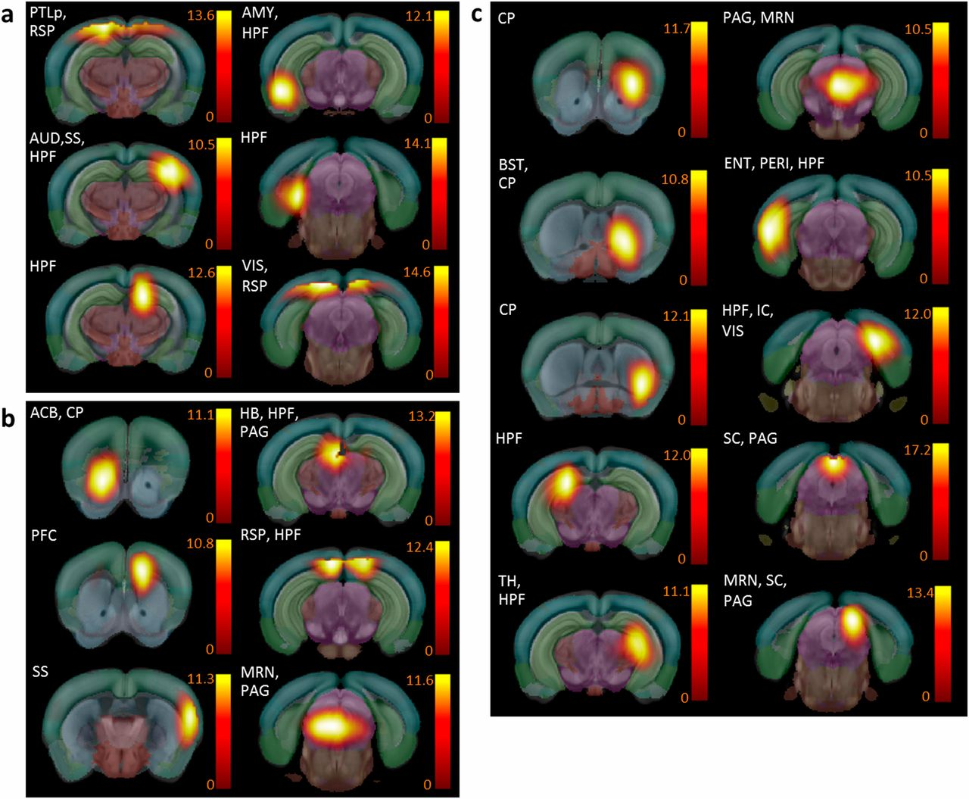
Mouse brain functional hubs defined as nodes displaying both above-mean normalized connection strength and diversity, and identified from positive correlation analysis, differ between Ctrl and Oprm1−/− mice.
Anna E. Mechling et al. PNAS 2016;113:11603-11608
©2016 by National Academy of Sciences
Notes:
Mouse brain functional hubs defined as nodes displaying both above-mean normalized connection strength and diversity, and identified from positive correlation analysis, differ between Ctrl and Oprm1^{−/−} mice. (A) Functional hubs found in both Ctrl (normalized strength > 0.24; diversity > 0.36) and Oprm1^{−/−} (normalized strength > 0.17; diversity > 0.34) mice (see SI Materials and Methods). (B) Hubs detected only in the Ctrl group (normalized strength > 0.24; diversity > 0.36 in Ctrl; but normalized strength < 0.17 and diversity < 0.34 in the Oprm1^{−/−} group). These hubs have lost their importance as connectivity relays in Oprm1^{−/−} mice. Among the hubs ACB, HB, and PAG, are known for their high expression of MORs in the normal brain. (C) Hubs detected only in the Oprm1^{−/−} group (normalized strength < 0.24 and diversity < 0.36 in Ctrl; but normalized strength > 0.17 and diversity > 0.34 in the Oprm1^{−/−} group). These hubs have gained importance in mutant mice connectional matrix and cover well-known pain/aversion processing areas, including the anterior cingulate cortex, somatosensory cortex, BNST, and HPF.

